Slide 1
Case Study 3: TastyBite’s Product Pricing & Profitability FY 2024 - 2025
Sai Jhansi Kongara
Student at Sharpener Tech

Slide 2
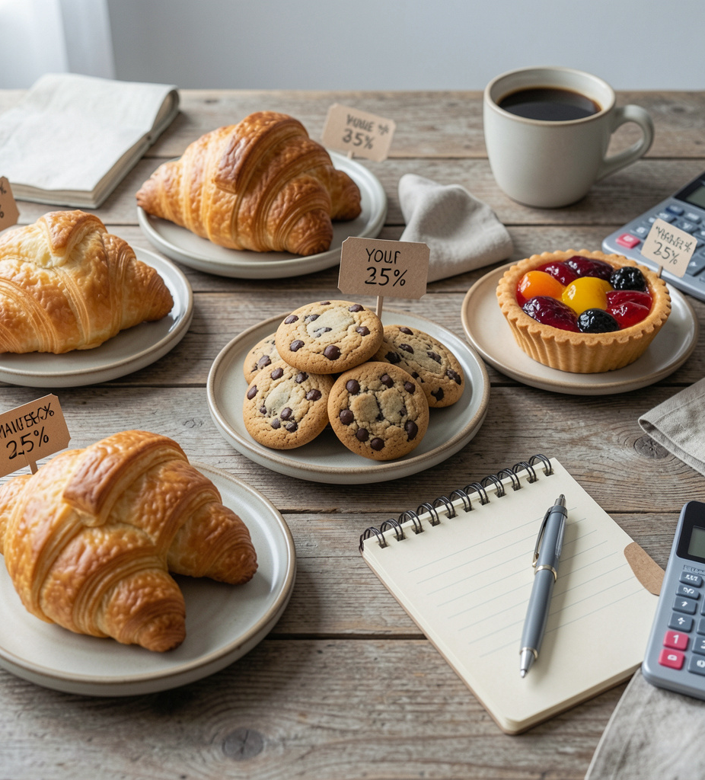
AIM
Analyze TastyBite’s Product Pricing & Profitability, a food delivery app operating in multiple cities. and to provide necessary business recommendations to generate more Profit.
Business Objectives:
Identify high-profit and low-profit products and categories.
To understand how discounts and promotions affect profit margins.
To recommend pricing optimization and promotional strategies to improve overall profitability without negatively affecting customer demand.
Tools Used:
Microsoft Power BI
Spreadsheet
ChatGPT

Slide 3
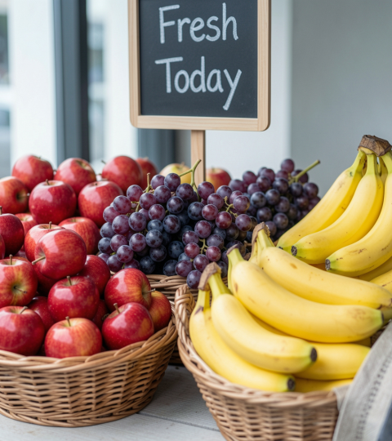
Business Analysis

Slide 4
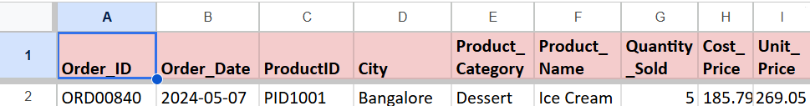
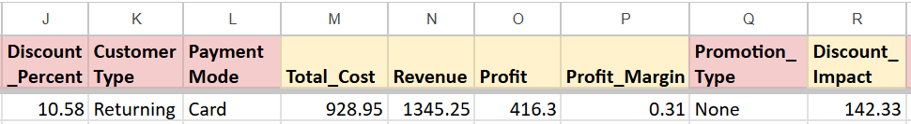
Dataset & EDA
Chatgpt driven Dataset.
Replacing null Values are with “0”.
Blank Text entries with “Unknown".
Revenue including Discount: =Quantity * (SellingPrice - (SellingPrice * DiscountPercent / 100))
1000 TastyBites Product Pricing & Profitability Data Entries FY 2024-2025

Slide 5
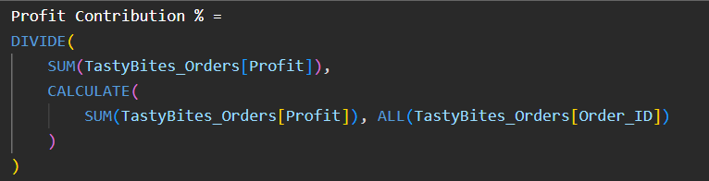
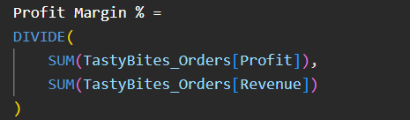
DAX Measures

Slide 6
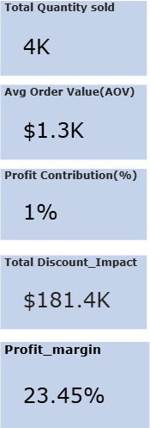
KPI Summary

Slide 7
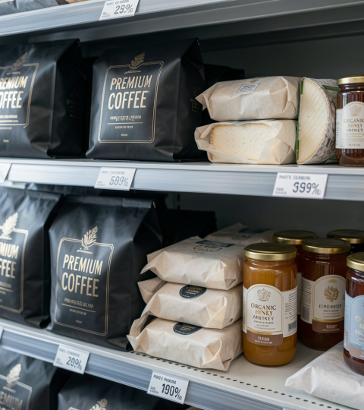
Business Insights and Recommendations
in terms of Quick wins and long-term strategies

Slide 8
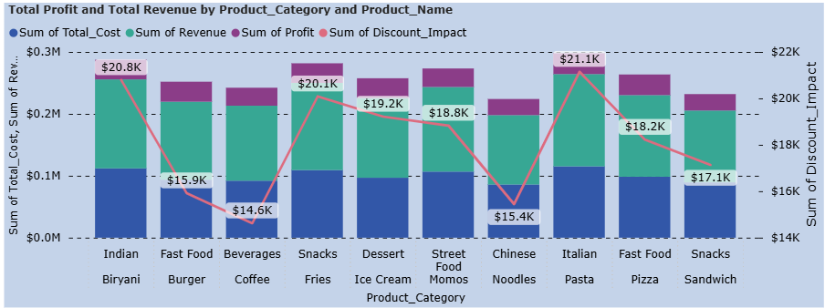
Food Product Performance
Most Profitable is Pizza compared to Italian Pasta because we spend more on it comparatively, least profitable are Chinese Noodles.
Revenue lost majorly on Indian Biryani.

Slide 9
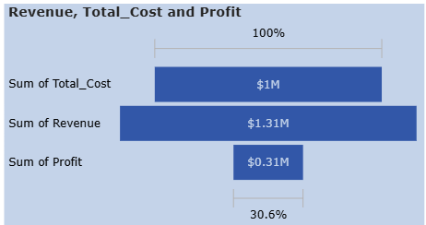
Food Product Performance
Quick wins(0–3 Months) Recommendations to actions:
Bundle high-profit products with low-profit products to improve overall profitability.
Long-term strategies(3–12 Months)
Implement profitability-based product segmentation (High, Medium, Low Profit Products).
Numerical Statistics:

Slide 10
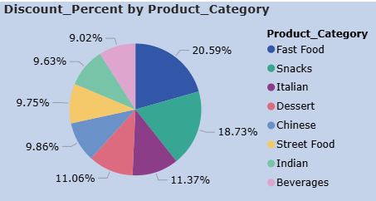
Discount Percent Analysis
Most Profitable is Pizza from Fast food on Slide No: 8

Slide 11
Discount Percent Analysis
Quick wins:
Test different discount levels (5%, 10%, 15%) to identify the most profitable option
Long-term strategies:
Develop dynamic discounting based on demand, inventory levels, and seasonality.

Slide 12
Conclusion
The Case Study analyzed product profitability to identify high-profit and low-profit products and understand how discounts and promotions impact overall profit margins.
The analysis revealed that while discounts can increase sales volume, excessive discounting often reduces profitability, particularly for low-margin products.
Pasta, followed by pizza, generated more revenue and showed a high profit
This may be varied across regions due to differences in food preferences, customer demand patterns, and purchasing behavior.
Implementing both short-term and long-term pricing strategies will help the company make data-driven decisions, protect profit margins, and achieve sustainable revenue and profitability growth.

Slide 13

THANK YOU
Any Questions?
Check out Working Model Here:
Case Study 3: TastyBites_Product Pricing & Profitability
Connect me at:
Sai Jhansi Kongara

